Slide 1
CWRU – Data Analytics Bootcamp – Final Project
Employee Turnover Prediction Model

Slide 2
Project and Data Overview:
Project Goal: Build and train a model to predict employee attrition.
Model Training Set: Kaggle, HR Analytics Dataset – Employee Turnover Rate Data
Location: https://www.kaggle.com/viveknimsarkar/hr-analytics-dataset
Size: 15,000 records x 10 features
Programming Tools and Components:
Data ETL/Model Pre-Processing: Python Pandas, Numpy, Scikit-Learn
Plotting/Visualizations: Matplotlib and/or JSPlotly
Database Architecture:
PostgreSQL: Multi-table SQL relational database capturing testing and training data as well as recording single or bulk records for end user predictions and retention.
Interactive Pages:
HTML/Flask (or similar): Interactive webpage with:
Welcome/Landing Page
Plots/Visualizations Page
User input page (single employee modeling)
Corporate Upload Page (multi record file upload for modeling)
Data Display Page
Hosting Architecture:
Heroku or AWS: Final interactive model will be hosted in either Heroku or AWS Cloud Environment.
Misc Components:
GitHub Repo: All code, versioning and file retention will be executed using GitHub.

Slide 3
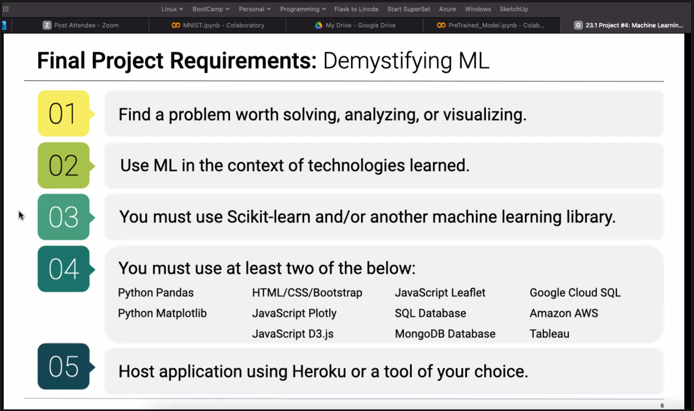

Slide 4
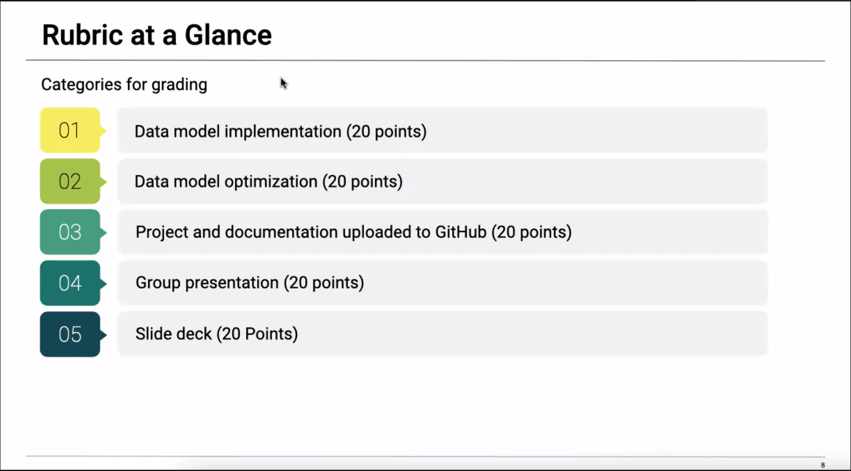

Slide 5
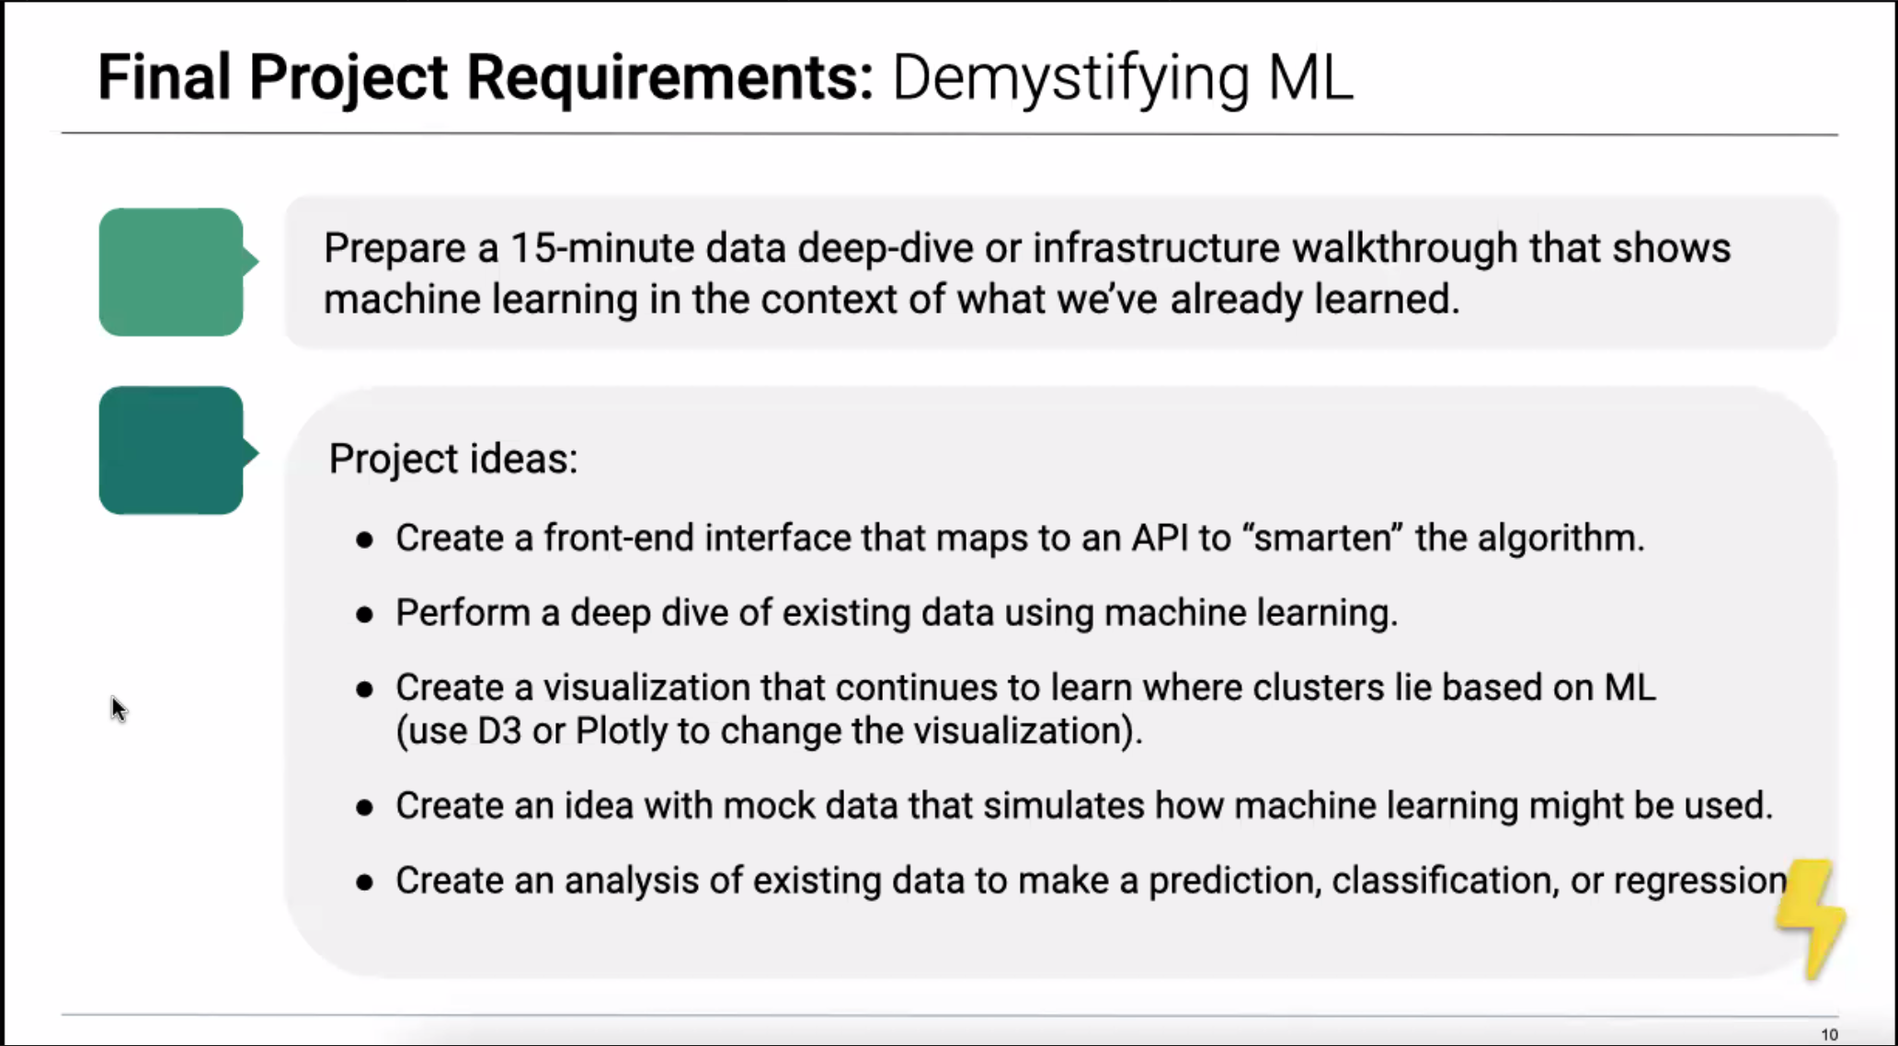

Slide 6
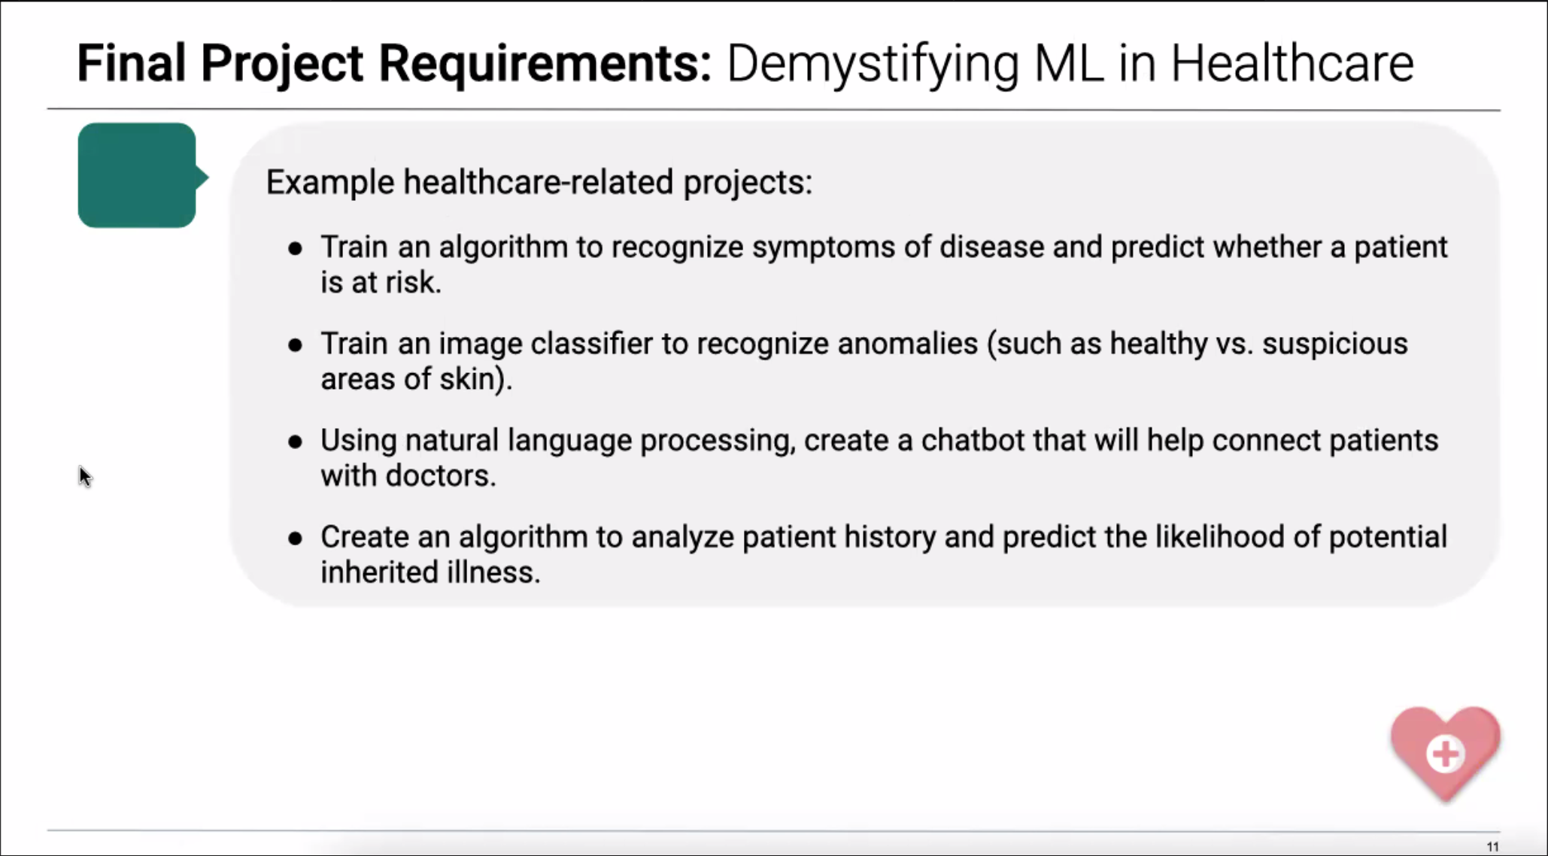

Slide 7
